Slide 1
Amazon RDS PostgreSQL – Security
Notes:
Hello my name is Sundar Raghavan and I am a Sr. Database specialist Solution architect.
Thank you for joining this train the trainer module on “Amazon RDS PostgreSQL Security“

Slide 2
Agenda
Introduction & Shared Responsibility Model
Amazon RDS - Layered Security
AWS IAM Policies
External Database Authentication (IAM / Kerberos)
Encryption in Transit (SSL/TLS)
Encryption at rest
Authorization in Amazon RDS PostgreSQL
Auditing in Amazon RDS PostgreSQL
Notes:
The agenda for this session would begin with a discussion on Security and compliance in general and shared security model Of RDS
We then look into IAM policies

Slide 3
Infrastructure and services to elevate your security in the cloud
Inherit global security & compliance controls
Scale with superior visibility & control
Highest standards for privacy & data security
Automate & reduce risk with deeply integrated services
Largest ecosystem of security partners & solutions
Notes:
Raise your security posture with AWS infrastructure and services
Using AWS, you will gain the control and confidence you need to securely run your business with the most flexible and secure cloud computing environment available today. As an AWS customer, you will benefit from AWS data centers and a network architected to protect your information, identities, applications, and devices. With AWS, you can improve your ability to meet core security and compliance requirements, such as data locality, protection, and confidentiality with our comprehensive services and features.
Today, AWS protects millions of active customers around the world. Our customers represent diverse industries with a wide range of use cases, including large enterprises, start-ups, educational institutions, and government organizations. The scale and global reach of these customers gives us broad visibility and deep perspective on cloud security, knowledge which we rapidly reinvest back into our leading edge infrastructure and services. All customers benefit from AWS being the only commercial cloud that has had its service offerings and associated supply chain vetted and accepted as secure enough for top-secret workloads.
AWS allows you to automate manual security tasks so you can shift your focus to scaling and innovating your business. Plus, you pay only for the services that you use. Use AWS to transform the way you do business, automating security and compliance tasks to reduce risk so you can grow and innovate faster, freeing up resources to focus on your customers and core business needs.
AWS has largest network of security partners and solutions. Extend the benefits of AWS by using security technology and consulting services from familiar solution providers you already know and trust.

Slide 4
Security and compliance
Network security
Amazon Virtual Private Cloud (VPC) security groups act as a virtual firewall to control inbound and outbound traffic
Resource access permissions
AWS Identity and Access Management (IAM) provides resource-level role permission controls
Data encryption
Encryption at rest using AWS KMS or Oracle/Microsoft TDE
SSL protection for data in transit
Compliance and assurance programs for finance, healthcare, government, and more
HIPAA eligibility under a Business Associate Agreement (BAA) with AWS
Active Directory / Kerberos integration
Amazon RDS for Oracle, SQL Server, PostgreSQL and Aurora PostgreSQL
Notes:
RDS makes it easy to control network access to your database. RDS also lets you run your database instances in Amazon Virtual Private Cloud (Amazon VPC), which enables you to isolate your database instances and to connect to your existing IT infrastructure through an industry-standard encrypted IPsec VPN. Many RDS engine types offer encryption at rest and all engines support encryption in transit. RDS offers a wide range of compliance readiness including HIPAA eligibility.

Slide 5
Shared Responsibility Model
Notes:
Security is a shared responsibility between AWS and you
Security of the cloud – AWS is responsible for protecting the infrastructure that runs AWS services in the AWS Cloud. AWS also provides you with services that you can use securely. Third-party auditors regularly test and verify the effectiveness of our security as part of the AWS compliance programs
Security in the cloud – Your responsibility is determined by the AWS service that you use. You are also responsible for other factors including the sensitivity of your data, your organization's requirements, and applicable laws and regulations.

Slide 6
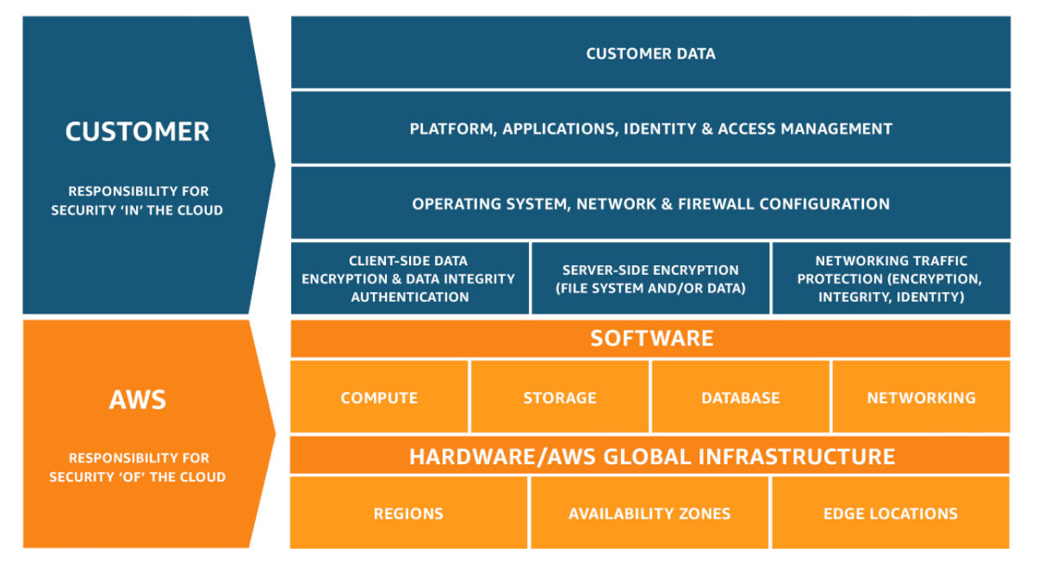
Shared Responsibility & RDS
AWS operates other layers of the stack (e.g. OS)
AWS provides service specific mechanisms to implement security and compliance controls
Customer responsible for using mechanisms properly
Notes:
You only have to configure security for your use cases. You don't have to configure security access for processes that Amazon RDS manages. These include creating backups, replicating data between a primary DB instance and a read replica, and other processes.

Slide 7
RDS security: layered mechanisms
Layer | Mechanisms/Features | Description
Network | VPC, subnets Security groups, NACLs Public access | Control where DB clusters are deployed, manage and restrict network access to DB resources. Access DB resources directly from the internet (not recommend).
Data protection | Encryption at rest Encryption in transit (TLS) | Storage level encryption of primary data, backups and metadata (logs, metrics). Support for encrypted connections to the DB.
Resource access | AWS IAM AWS Organizations | Access control for DB cluster lifecycle and supporting resources
DB authentication and authorization | IAM authentication Kerberos authentication Native authentication Native authorization | Authentication mechanisms to interact with data stored in the DB cluster. Control level of access to data. Store, access, manage and rotate native credentials using AWS Secrets Manager.
Audit | Database Activity Streams VPC flow logs Publish logs to CloudWatch Logs | Log DB activity or network traffic for DB clusters
Notes:
You can manage access to your Amazon RDS resources and your databases on a DB instance. The method you use to manage access depends on what type of task the user needs to perform with Amazon RDS:
(RDS lets you) Run your DB instance in a virtual private cloud (VPC) based on the Amazon VPC service for the greatest possible network access control.
(RDS lets you) Use AWS Identity and Access Management (IAM) policies to assign permissions that determine who is allowed to manage Amazon RDS resources. For example, you can use IAM to determine who is allowed to create, describe, modify, and delete DB instances, tag resources, or modify security groups.
(RDS lets you) Use security groups to control what IP addresses or Amazon EC2 instances can connect to your databases on a DB instance. When you first create a DB instance, its firewall prevents any database access except through rules specified by an associated security group.
(RDS lets you) Use Secure Socket Layer (SSL) or Transport Layer Security (TLS) connections with DB instances
(RDS lets you) Use Amazon RDS encryption to secure your DB instances and snapshots at rest. Amazon RDS encryption uses the industry standard AES-256 encryption algorithm to encrypt your data on the server that hosts your DB instance.
(RDS lets you) Use network encryption and transparent data encryption with Oracle DB instances;
(RDS lets you) Use the security features of your DB engine to control who can log in to the databases on a DB instance. These features work just as if the database was on your local network.

Slide 8
Secure network access Controlled through Amazon Virtual Private Cloud (VPC) security groups
Protocol | Port range | Source
TCP | 5432 | 172.31.0.0/16
TCP | 5432 | “Application security group”
Corporate address admins
M
Application tier
Notes:
A VPC security group allows you to specify access rules for your database. Each rule is a combination of protocol, port range, and source of the traffic that you allow into your database. For the source, you can set up an IP address, a particular CIDR block covering multiple IP addresses, or even another security group. This gives you the flexibility to have a multi-tier architecture for database access.

Slide 9
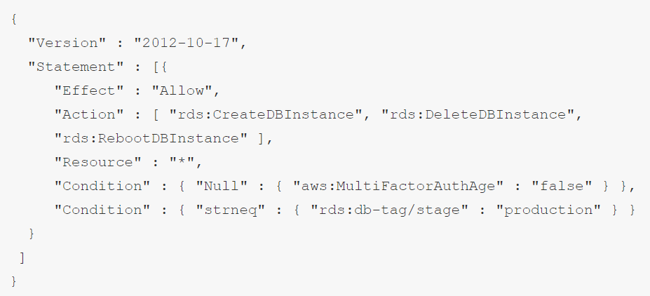
Resource-level role permissions Enabled through AWS Identity and Access Management (IAM)
Governed access: use IAM to control who can perform actions with Amazon RDS
DBA and Ops
RDS
Notes:
RDS is integrated with AWS Identity and Access Management (IAM) and provides you the ability to control the actions that your IAM users and groups can take on specific RDS resources, from database instances through snapshots, parameter groups, and option groups. You can also tag your RDS resources and control the actions that your IAM users and groups can take on groups of resources that have the same tag and associated value. For example, you can configure your IAM rules to ensure developers are able to modify "Development" database instances, but only Database Administrators can make changes to "Production" database instances.

Slide 10
Authentication
Ensures only authorized users connect to the database
Several authentication mechanisms available based on need and environment
AWS Identity and Access Management (IAM)
Kerberos
PostgreSQL local accounts
Notes:
Amazon RDS supports several ways to authenticate database users.
Password, Kerberos, and IAM database authentication use different methods of authenticating to the database. Therefore, a specific user can log in to a database using only one authentication method.
For PostgreSQL, use only one of the following role settings for a user of a specific database:
-To use IAM database authentication, assign the rds_iam role to the user.
-To use Kerberos authentication, assign the rds_ad role to the user.
-To use password authentication, don't assign either the rds_iam or rds_ad roles to the user.

Slide 11

AWS Identity and Access Management (IAM)
PostgreSQL authentication is managed externally using IAM
Authentication tokens are used to validate the user
Tokens have a lifetime of 15 minutes
Connections per second are limited by the instance type of the database
AWS Identity and Access Management
Notes:
You can authenticate to your DB instance using AWS Identity and Access Management (IAM) database authentication. IAM database authentication works with PostgreSQL. With this authentication method, you don't need to use a password when you connect to a DB instance. Instead, you use an authentication token.
An authentication token is a unique string of characters that Amazon RDS generates on request. Authentication tokens are generated using AWS Signature Version 4. Each token has a lifetime of 15 minutes. You don't need to store user credentials in the database, because authentication is managed externally using IAM. You can also still use standard database authentication.
With IAM database authentication the
Network traffic to and from the database is encrypted using Secure Socket Layer (SSL) or Transport Layer Security (TLS).
You can use IAM to centrally manage access to your database resources, instead of managing access individually on each DB instance.
For applications running on Amazon EC2, you can use profile credentials specific to your EC2 instance to access your database instead of a password, for greater security.

Slide 12





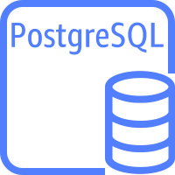
Kerberos authentication
Region
Provides a fast and secure authentication mechanism
Uses AWS Directory Service for Microsoft Active Directory (AWS Managed Microsoft AD) as the authentication source
The client must be part of the AWS Managed Microsoft AD domain
Availability zone A
Availability zone B
VPC
Kerberos ticket
AWS Managed Microsoft AD
Client
Kerberos ticket
Amazon RDS PostgreSQL
Notes:
Amazon RDS supports external authentication of database users using Kerberos and Microsoft Active Directory. Kerberos is a network authentication protocol that uses tickets and symmetric-key cryptography to eliminate the need to transmit passwords over the network. Kerberos has been built into Active Directory and is designed to authenticate users to network resources, such as databases.
You can use Kerberos authentication to authenticate users when they connect to your DB instance running PostgreSQL. In this case, your DB instance works with AWS Directory Service for Microsoft Active Directory to enable Kerberos authentication.

Slide 13
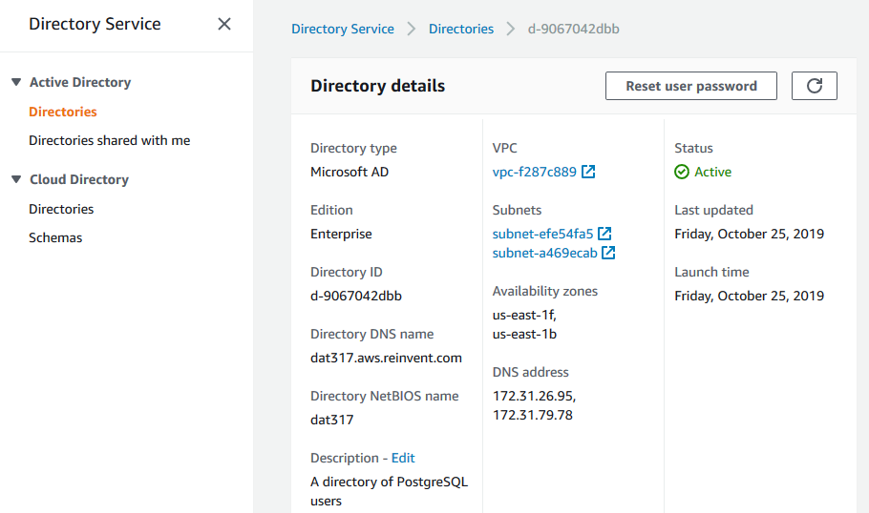
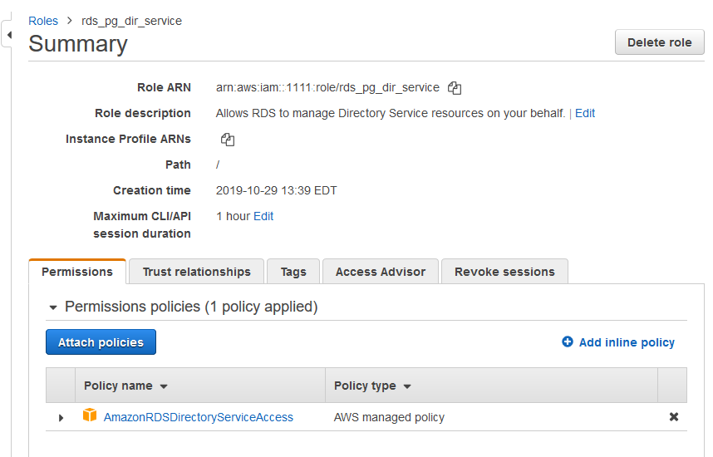
Kerberos authentication
Create a directory
It needs to be an AWS Managed Microsoft AD
Create an IAM role so RDS can access the directory
The role needs AmazonRDSDirectoryServiceAccess privileges
Notes:
Here are the screen shots that explains how Kerberos Authentication can be configured via AWS Console
---
Keeping all of your credentials in the same directory can save you time and effort. You have a centralized place for storing and managing credentials for multiple DB instances.
Using a directory can also improve your overall security profile.
-----
Here is how the Amazon RDS PostgreSQL Authentication with Kerberos works.
(Click) You create an AWS Managed Microsoft directory (AWS MAD) to store user credentials.
(Click) You then provide Active Directory's domain and other information to your PostgreSQL DB instance
When users authenticate with the PostgreSQL DB instance, authentication requests are forwarded to the AWS Managed Microsoft directory.
---
You can also access credentials from your own on-premises Microsoft Active Directory. To do so you create a trusting domain relationship so that the AWS Managed Microsoft AD directory trusts your on-premises Microsoft Active Directory. In this way, your users can access your PostgreSQL instances with the same Windows single sign-on (SSO) experience as when they access workloads in your on-premises network.

Slide 14
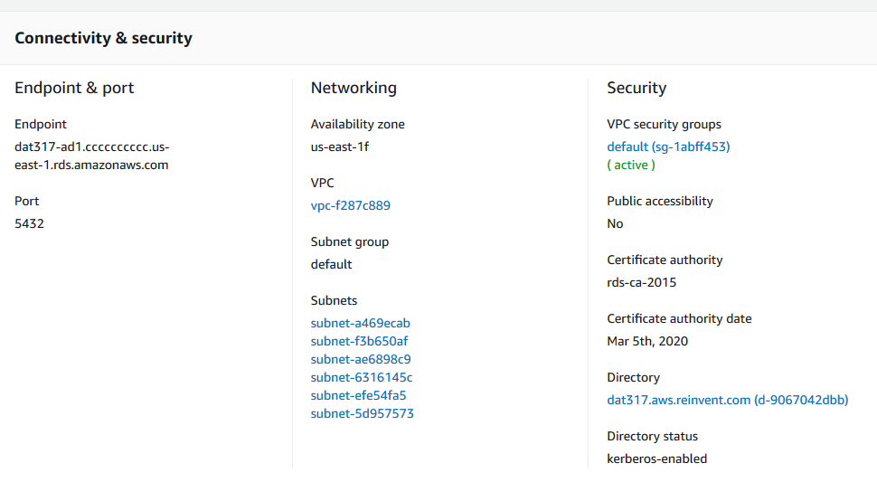
Kerberos authentication
Connect the directory and role to the database instance
aws rds modify-db-instance \
--db-instance-identifier dat317-ad \
--domain d-9067042dbb \
--domain-iam-role-name rds_pg_ad_service
Notes:
You can also modify an existing RDS Instance to us a AWS Managed Microsoft AD.
Here is an example given on how to do it using AWS CLI

Slide 15
Kerberos authentication
ALL CAPS
Create a role with login privileges that matches the domain user
Add the login role to the rds_ad role
CREATE ROLE "jim@DAT317.AWS.REINVENT.COM" WITH LOGIN;
CREATE ROLE “Kevin@DAT317.AWS.REINVENT.COM" WITH LOGIN;
GRANT rds_ad TO "jim@DAT317.AWS.REINVENT.COM";
GRANT rds_ad TO “Kevin@DAT317.AWS.REINVENT.COM";
Case matters
Notes:
As you know in PG a Role with login privilege is a user, as you create a role in the PostgreSQL, make sure that it is case sensitive. A Pre created role rds_ad is essential for newly created user/role to communicate to the Managed AD

Slide 16
Repeatedly creating users
v_user := p_user || '@' || upper(p_domain);
IF v_user IS NULL THEN
RAISE EXCEPTION 'The user or domain can
not be null';
END IF;
IF length(v_user) > 63 THEN
RAISE EXCEPTION 'The domain username (%)
is too long. Usernames are limited to
63 characters', v_user;
END IF;
CREATE OR REPLACE PROCEDURE create_ad_user(
p_user text,
p_domain text DEFAULT 'DAT317.AWS.REINVENT.COM')
AS $$
DECLARE
v_user text;
v_role text;
BEGIN
v_user := p_user || '@' || upper(p_domain);
IF v_user IS NULL THEN
RAISE EXCEPTION 'The user or domain can
not be null';
END IF;
IF length(v_user) > 63 THEN
RAISE EXCEPTION 'The domain username (%)
is too long. Usernames are limited to
63 characters', v_user;
END IF;
EXECUTE format('CREATE ROLE %I WITH LOGIN',
v_user);
EXECUTE format('GRANT rds_ad TO %I', v_user);
EXECUTE format('GRANT ad_users TO %I', v_user);
RAISE NOTICE 'Created AD user %', v_user;
END $$
LANGUAGE plpgsql
SECURITY DEFINER;
CREATE OR REPLACE PROCEDURE create_ad_user(
p_user text,
p_domain text
DEFAULT 'DAT317.AWS.REINVENT.COM')
AS $$
DECLARE
v_user text;
v_role text;
BEGIN
END $$
LANGUAGE plpgsql
SECURITY DEFINER;
EXECUTE format('CREATE ROLE %I WITH LOGIN',
v_user);
EXECUTE format('GRANT rds_ad TO %I', v_user);
EXECUTE format('GRANT ad_users TO %I', v_user);
RAISE NOTICE 'Created AD user %', v_user;

Slide 17
Local authentication
Stores the login information in the local system catalogs for the instance
Default method uses MD5 with a salt for authentication
Fast authentication times but no control over password complexity
CREATE USER rptuser
PASSWORD ‘5tr0ngP@ssw0rd!'
VALID UNTIL '2019-12-31 12:15';
ALTER USER rptuser
PASSWORD ‘weakpassword’;
Notes:
With password authentication, your DB instance performs all administration of user accounts. You create users with SQL statements such as CREATE USER and specify passwords.
All RDS DB engines (including RDS PostgreSQL) support password authentication
With password authentication, your database controls and authenticates user accounts. If a DB engine has strong password management features, they can enhance security. Database authentication might be easier to administer using password authentication when you have small user communities. Because clear text passwords are generated in this case, integrating with AWS Secrets Manager can enhance security.

Slide 18
Restricted password management
Limits the users capable of changing passwords and expiration times
By default, it is disabled
Set rds. restrict_password_commands to 1 to enable the feature
Only members of the rds_password role can make changes
ALTER USER rptuser
PASSWORD ‘weakpassword’;
ERROR: must be a member of rds_password
to alter passwords
Notes:
You can restrict who can manage database user passwords to a special role. By doing this, you can have more control over password management on the client side.
You enable restricted password management with the static parameter rds.restrict_password_commands and use a role called rds_password.
When the parameter rds.restrict_password_commands is set to 1, only users that are members of the rds_password role can run certain SQL commands.
The restricted SQL commands are commands that modify database user passwords and password expiration time.
To use restricted password management, your DB instance must be running Amazon RDS for PostgreSQL 10.6 or higher
The rds_superuser role has membership for the rds_password role by default, and you can't change this.
Because the rds.restrict_password_commands parameter is static, changing this parameter requires a database restart.
When a database has restricted password management enabled, if you try to run restricted SQL commands you get the following error: ERROR: must be a member of rds_password to alter passwords.
Make sure that you verify password requirements such as expiration and needed complexity on the client side.
We recommend that you restrict password-related changes by using your own client-side utility. This utility should have a role that is a member of rds_password and has the CREATEROLE role attribute.

Slide 19

AWS Secrets Manager
Lifecycle management for secrets such as database passwords
Safely rotates passwords
Built-in integration with RDS and Aurora PostgreSQL
With restricted password management, all passwords can be controlled by Secrets Manager
AWS Secrets Manager
Notes:
AWS Secrets Manager is a secrets management service that helps you protect access to your applications, services, and IT resources.
Using Secrets Manager, you can secure and manage secrets used to access resources in the AWS Cloud, on third-party services, and on-premises.
You can encrypt secrets at rest to reduce the likelihood of unauthorized users viewing sensitive information.
To retrieve secrets, you simply replace secrets in plain text in your applications with code to pull in those secrets programmatically using the Secrets Manager APIs.
You use AWS IAM policies to control which users and applications can access these secrets. You can rotate passwords, on a schedule or on demand, for supported database types hosted on AWS, without a risk of impacting applications.
You can extend this functionality to rotate other secrets, such as passwords for Oracle databases hosted on Amazon EC2 or OAuth refresh tokens, by modifying sample Lambda functions. You can also audit and monitor secrets because Secrets Manager integrates with AWS CloudTrail, Amazon CloudWatch, and Amazon SNS

Slide 20
Choosing an authentication method
Multiple methods can be used
Use Kerberos in active directory environments
Use IAM for high-security environments with low to moderate connection requirements
Use local authentication with Secrets Manager for high connection requirements

Slide 21
Encryption of data at rest
AES256-based storage encryption, incl. backups, snapshots and metadata (Performance Insights, CloudWatch Logs, Enhanced Monitoring)
Key management using AWS KMS
No performance impact on workloads
Other options:
Encryption functions (no key mgmt.)
Client-side encryption
Notes:
Amazon RDS encrypted DB instances provide an additional layer of data protection by securing your data from unauthorized access to the underlying storage.
You can use Amazon RDS encryption to increase data protection of your applications deployed in the cloud, and to fulfill compliance requirements for encryption at rest.
For an Amazon RDS encrypted DB instance, all logs, backups, and snapshots are encrypted. Amazon RDS uses an AWS KMS customer master key (CMK) to encrypt these resources.
Amazon RDS encrypted DB instances use the industry standard AES-256 encryption algorithm to encrypt your data on the server that hosts your Amazon RDS DB instances.
After your data is encrypted, Amazon RDS handles authentication of access and decryption of your data transparently with a minimal impact on performance. You don't need to modify your database client applications to use encryption.
A read replica of an Amazon RDS encrypted instance must be encrypted using the same CMK as the primary DB instance when both are in the same AWS Region.
If the primary DB instance and read replica are in different AWS Regions, you encrypt the read replica using the CMK for that AWS Region.

Slide 22
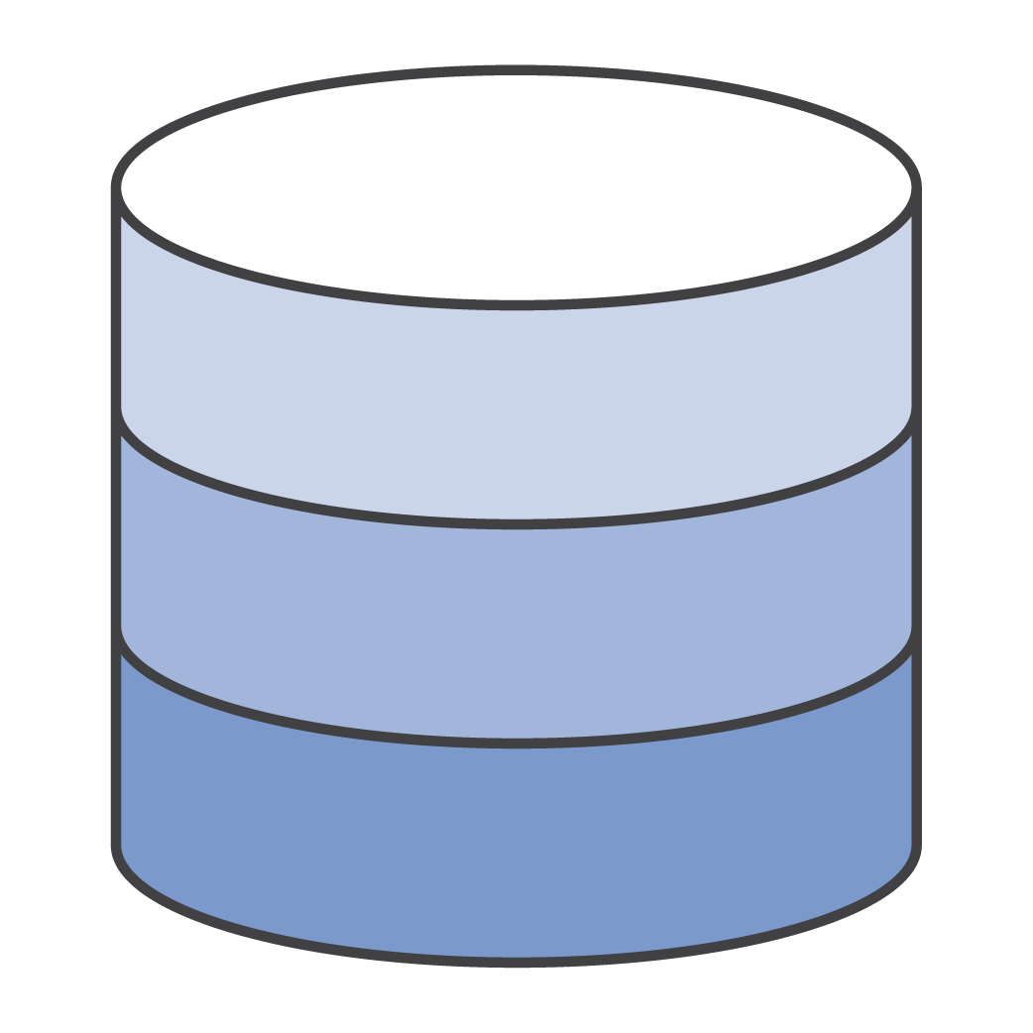

Network encryption (server side)
Encryption in transit is fully supported for all Amazon RDS and Aurora database engine types
A region-specific SSL certificate is available on Amazon RDS instances
Used to encrypt network traffic
Also used to verify the endpoint to guard against spoofing attacks
By default, SSL is optional
Set rds.force_ssl to 1 to force SSL
The client requests the type of SSL connection
Notes:
RDS PostgreSQL database engines allow you to establish Transport Layer Security (TLS) encrypted connections to the database engine. These connections are frequently also called Secure Sockets Layer (SSL) encryption, although that term specifically refers to the now-deprecated predecessor cryptographic protocol of TLS, which is not supported by RDS.
RDS creates an SSL certificate and installs the certificate on the DB instance when RDS provisions the instance. A certificate authority signs these certificates. The SSL certificate includes the DB instance endpoint as the common name (CN) for the SSL certificate to guard against spoofing attacks.
By default, SSL is optional
Set rds.force_ssl to 1 to force SSL

Slide 23
Network encryption (Client side)
$ psql -h $RDSHOST \
"user=jim dbname=postgres sslmode=require"
postgres=> SELECT ssl,version, bits
FROM pg_stat_ssl
WHERE pid = pg_backend_pid();
ssl | version | bits
-----+---------+------
t | TLSv1.2 | 256
(1 row)
An SSL certificate is available on RDS instances
Used to encrypt network traffic
Also used to verify the endpoint to guard against spoofing attacks
By default, SSL is optional
Set rds.force_ssl to 1 to force SSL
The client requests the type of SSL connection
Notes:
Requiring an SSL connection to a PostgreSQL DB instance
You can require that connections to your PostgreSQL DB instance use SSL by using the rds.force_ssl parameter. B
By default, the rds.force_ssl parameter is set to 0 (off). You can set the rds.force_ssl parameter to 1 (on) to require SSL for connections to your DB instance.
Updating the rds.force_ssl parameter also sets the PostgreSQL ssl parameter to 1 (on) and modifies your DB instance's pg_hba.conf file to support the new SSL configuration.
You can set the rds.force_ssl parameter value by updating the parameter group for your DB instance.
If the parameter group for your DB instance isn't the default one, and the ssl parameter is already set to 1 when you set rds.force_ssl to 1, you don't need to reboot your DB instance.
Otherwise, you must reboot your DB instance for the change to take effect

Slide 24
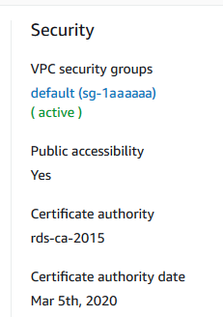
Network encryption
The SSL connection can be verified by using a stricter SSL mode
psql -h $RDSHOST \
"user=postgres dbname=postgres \
sslmode=verify-full \
sslrootcert=rds-ca-2015-root.pem"
Certificates need to be updated
Notes:
Amazon RDS supports Secure Socket Layer (SSL) encryption for PostgreSQL DB instances. Using SSL, you can encrypt a PostgreSQL connection between your applications and your PostgreSQL DB instances. You can also force all connections to your PostgreSQL DB instance to use SSL.
To connect to a PostgreSQL DB instance over SSL
Download the certificate.
Import the certificate into your operating system.
Connect to your PostgreSQL DB instance over SSL.

Slide 25
Network encryption (client side): psql example
Setting SSL mode on the connection string determines the SSL connection
SSL mode options
psql -h $RDSHOST -p 5432 \
"dbname=postgres user=jim \
sslrootcert=rds-bundle.pem \
sslmode=verify-ca"
psql -h $RDSHOST -p 5432 \
"dbname=postgres user=jim \
sslrootcert=rds-bundle.pem \
sslmode=verify-full"
psql -h $RDSHOST -p 5432 \
"dbname=postgres user=jim \
sslmode=require"
psql -h $RDSHOST -p 5432 \
"dbname=postgres user=jim"
disable | require
allow | verify-ca
prefer | verify-full
Checks the certificate is from a known certificate authority
ensures the client is connecting to an RDS server
Guards against disabling SSL on the server
Verifies the host name in addition to the certificate
Default
Notes:
The different values for the sslmode parameter provide different levels of protection. SSL can provide protection against three types of attacks:
Eavesdropping
If a third party can examine the network traffic between the client and the server, it can read both connection information (including the user name and password) and the data that is passed. SSL uses encryption to prevent this.
Man in the middle (MITM)
If a third party can modify the data while passing between the client and server, it can pretend to be the server and therefore see and modify data even if it is encrypted. The third party can then forward the connection information and data to the original server, making it impossible to detect this attack. Common vectors to do this include DNS poisoning and address hijacking, whereby the client is directed to a different server than intended. There are also several other attack methods that can accomplish this. SSL uses certificate verification to prevent this, by authenticating the server to the client.
Impersonation
If a third party can pretend to be an authorized client, it can simply access data it should not have access to. Typically this can happen through insecure password management. SSL uses client certificates to prevent this, by making sure that only holders of valid certificates can access the server.
Disable - I don't care about security, and I don't want to pay the overhead of encryption.
Allow - I don't care about security, but I will pay the overhead of encryption if the server insists on it.
Prefer - I don't care about encryption, but I wish to pay the overhead of encryption if the server supports it.
Require - I want my data to be encrypted, and I accept the overhead. I trust that the network will make sure I always connect to the server I want.
verify-ca - I want my data encrypted, and I accept the overhead. I want to be sure that I connect to a server that I trust.
verify-full - I want my data encrypted, and I accept the overhead. I want to be sure that I connect to a server I trust, and that it's the one I specify.
The difference between verify-ca and verify-full depends on the policy of the root CA. If a public CA is used, verify-ca allows connections to a server that somebody else may have registered with the CA. In this case, verify-full should always be used. If a local CA is used, or even a self-signed certificate, using verify-ca often provides enough protection.

Slide 26
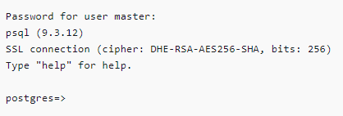
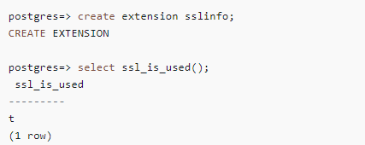
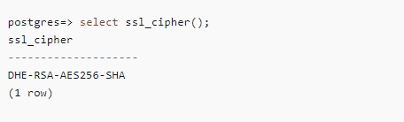
Determining the SSL Connection status
Extension - sslinfo
Logon Banner
ssl_cipher()
Notes:
Here are some methods by which you can determine the status of SSL connections
The encrypted status of your connection is shown in the logon banner when you connect to the DB instance
You can also load the sslinfo extension and then call the ssl_is_used() function to determine if SSL is being used. The function returns t if the connection is using SSL, otherwise it returns f.
You can use the select ssl_cipher() command to determine the SSL cipher
If you enable set rds.force_ssl and restart your instance, non-SSL connections are refused with the following message:

Slide 27
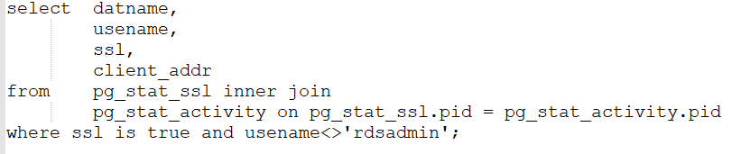
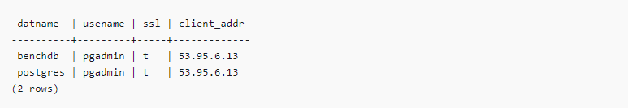
Query to determining if the application is using SSL

Slide 28
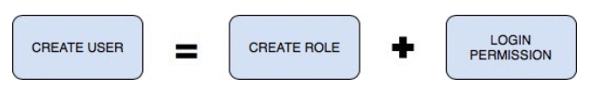
Database Authorization in PostgreSQL
Model: PostgreSQL users and role with resource grants
Users, groups, and roles are the same thing in PostgreSQL, with the only difference being that users have permission to log in by default
PostgreSQL handles credentialing using roles. Roles that can log in are called login roles
Note: Recent versions of PostgreSQL no longer use the terms users and groups. For backward compatibility, CREATE USER and CREATE GROUP still work in current versions, but shun them and use CREATE ROLE instead.
Notes:
PostgreSQL is one of the most popular open-source relational database systems. With more than 30 years of development work, PostgreSQL has proven to be a highly reliable and robust database that can handle a large number of complicated data workloads.
With PostgreSQL, you can create users and roles with granular access permissions. The new user or role must be selectively granted the required permissions for each database object.
This gives a lot of power to the end user, but at the same time, it makes the process of creating users and roles with the correct permissions potentially complicated.

Slide 29

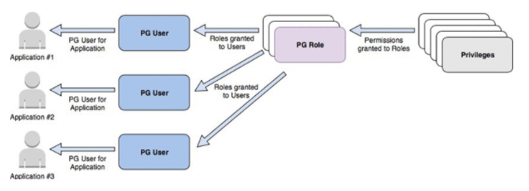
Database Authorization in PostgreSQL
PostgreSQL Instance
MGMT Database |  | FIN Database |  | Users or Roles
HR Schema | Payroll Schema | General Ledge Schema | Accounting Schema
hr_t1,hr_t2 | pr_t1,pr_t2 | gl_t1,gl_t2 | acc_t1,acc_t2
AWS Identity and Access Management (IAM)
The recommended approach for setting up fine-grained access control in PostgreSQL
Schemas organize your tables into logical groups. More like a search path
Notes:
Here is a sample PostgreSQL authentication/Authorization model. I would be showing a demo for this in a while but here is how it looks from the database perspective.

Slide 30



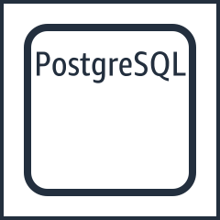

How do I manage log files?
Publish query and error logs in real time to Amazon CloudWatch logs
Set Amazon CloudWatch alarms based on text search patterns
Supported engines are MySQL, PostgreSQL, MariaDB, and Oracle
MySQL DB instance alternate
Amazon CloudWatch Logs
CloudWatch
alarms
PostgreSQL instance
Oracle DB instance
Notes:
Monitoring is an important part of maintaining the reliability, availability, and performance of Amazon RDS and your AWS solutions. You should collect monitoring data from all of the parts of your AWS solution so that you can more easily debug a multi-point failure if one occurs. AWS provides several tools for monitoring your Amazon RDS resources and responding to potential incidents:
Amazon CloudWatch AlarmsUsing Amazon CloudWatch alarms, you watch a single metric over a time period that you specify. If the metric exceeds a given threshold, a notification is sent to an Amazon SNS topic or AWS Auto Scaling policy. CloudWatch alarms do not invoke actions because they are in a particular state. Rather the state must have changed and been maintained for a specified number of periods.
AWS CloudTrail LogsCloudTrail provides a record of actions taken by a user, role, or an AWS service in Amazon RDS. CloudTrail captures all API calls for Amazon RDS as events, including calls from the console and from code calls to Amazon RDS API operations. Using the information collected by CloudTrail, you can determine the request that was made to Amazon RDS, the IP address from which the request was made, who made the request, when it was made, and additional details

Slide 31
Auditing in Amazon RDS PostgreSQL
Object security involves tracking who accessed data in addition to restricting access
* Auditing will log all required tracking of actions
CREATE EXTENSION pgaudit;
Notes:
The PostgreSQL Audit Extension (pgAudit) provides detailed session and/or object audit logging via the standard PostgreSQL logging facility.

Slide 32
Auditing (cont.)
What to audit
ALTER DATABASE SET pgaudit.log = 'READ,ROLE,DDL';

Slide 33
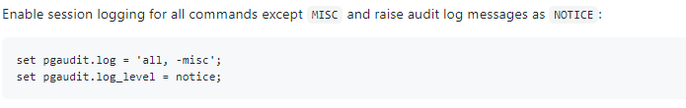
Classes | Description
READ | SELECT and COPY FROM
WRITE | INSERT, UPDATE, DELETE, TRUNCATE, etc
FUNCTION | Function calls and DO blocks
ROLE | Statements related to roles and privileges
DDL | All DDL that is not included in the ROLE class
MISC | Miscellaneous commands, e.g. VACUUM
Notes:
Specifies which classes of statements will be logged by session audit logging. Possible values are:
READ: SELECT and COPY when the source is a relation or a query.
WRITE: INSERT, UPDATE, DELETE, TRUNCATE, and COPY when the destination is a relation.
FUNCTION: Function calls and DO blocks.
ROLE: Statements related to roles and privileges: GRANT, REVOKE, CREATE/ALTER/DROP ROLE.
DDL: All DDL that is not included in the ROLE class.
MISC: Miscellaneous commands, e.g. DISCARD, FETCH, CHECKPOINT, VACUUM, SET.
MISC_SET: Miscellaneous SET commands, e.g. SET ROLE.
ALL: Include all of the above.
Multiple classes can be provided using a comma-separated list and classes can be subtracted by prefacing the class with a - sign (see Session Audit Logging).
The default is none.

Slide 34
Object Auditing
Usually only specific objects need to be auditing instead of the entire database
This reduces log volume significantly - For example, only the credit card table is audited but the postal code lookup table is not

Slide 35
Object Auditing (cont.)
Object auditing is implemented using roles
CREATE ROLE auditor; ALTER SYSTEM SET pgaudit.role = 'auditor'; GRANT SELECT, INSERT, DELETE ON bar TO auditor;

Slide 36
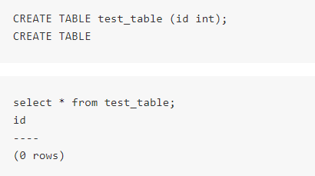
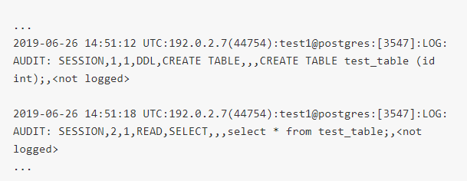
Reading the Audit Logs
Audit records are added to the normal PostgreSQL logs in the following CSV format
Action : Audit Log:

Slide 37
Field | Description
AUDIT_TYPE | SESSION or OBJECT
STATEMENT_ID | Unique statement ID for the session
SUBSTATEMENT_ID | Substatement ID
CLASS | e.g. (READ, ROLE)
COMMAND | e.g. ALTER TABLE, SELECT.
OBJECT_TYPE | TABLE, INDEX, VIEW, etc
OBJECT_NAME | The fully-qualified object name
STATEMENT | Statement executed on the backend
PARAMETER | Statement parameters

Slide 38
Thank you

Slide 39
LABS!

